Slide 1
Module 1 : Introduction
Dr Manish Potey
Professor
Department of Computer Engineering
K J Somaiya College of Engineering, Mumbai
manishpotey@somaiya.edu
Manish Potey

Slide 2
Introduction
1. Cloud Computing at a Glance
2. Historical Development
Building Cloud Computing Environments
Computing Platforms and Technologies
Summary
Manish Potey

Slide 3
1.1 Cloud computing at a glance
Cloud computing is a technological advancement that focuses on the way we design computing systems, develop applications, and leverage existing services for building software.
It is based on the concept of dynamic provisioning, which is applied not only to services but also to compute capability, storage, networking, and information technology (IT) infrastructure
Resources are made available through the Internet and offered on a pay-per-use basis from cloud computing vendors
Manish Potey

Slide 4
1.1 Cloud computing at a glance
In 1969, Leonard Kleinrock, one of the chief scientists of the original Advanced Research Projects Agency Network (ARPANET), which seeded the Internet, said:
  As of now, computer networks are still in their infancy, but as they grow up and become sophisticated, we will probably see the spread of ‘computer utilities’ which, like present electric and tele-phone utilities, will service individual homes and offices across the country
  This vision of computing utilities based on a service-provisioning model anticipated the massive transformation of the entire computing industry in the 21st century, whereby computing services will be readily available on demand , just as other utility services such as water, electricity, telephone, and gas are available in today’s society.
Manish Potey

Slide 5
1.1 Cloud computing at a glance
One of the most diffuse views of cloud computing can be summarized as follows:
  I don’t care where my servers are, who manages them, where my documents are stored, or where my applications are hosted. I just want them always available and access them from any device connected through Internet. And I am willing to pay for this service for as a long as I need it
With the wide deployment of cloud computing systems, the foundation technologies and systems enabling them are becoming consolidated and standardized.
This is a fundamental step in the realization of the long-term vision for cloud computing, which provides an open environment where computing, storage, and other services are traded as computing utilities.
Manish Potey

Slide 6
1.1 Cloud computing Vision
Cloud computing allows anyone with a credit card to provision virtual hardware, runtime environments, and services.
The entire stack of a computing system is transformed into a collection of utilities, which can be provisioned and composed together to deploy systems in hours rather than days and with virtually no maintenance costs.
The long-term vision of cloud computing is that IT services are traded as utilities in an open market, without technological and legal barriers.
Manish Potey

Slide 7
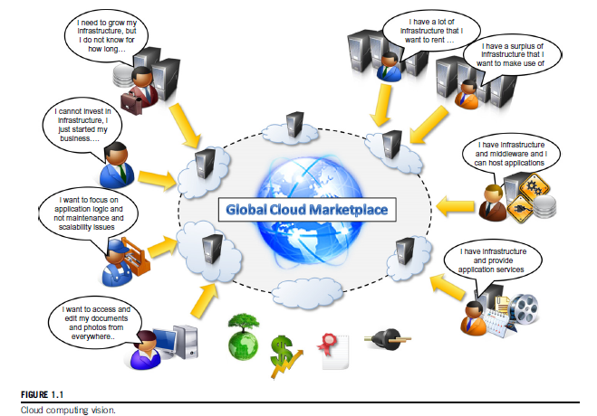
1.1 Cloud computing Vision
Manish Potey

Slide 8
1.1.2 Defining a cloud
Manish Potey

Slide 9
1.1.3 A closer look
Cloud computing is helping enterprises, governments, public and private institutions, and research organizations shape more effective and demand-driven computing systems.
Practical examples
  Large enterprises can offload some of their activities to cloud-based systems.
    Recently, the New York Times has converted its digital library of past editions into a Web-friendly format. This required a considerable amount of computing power for a short period of time. By renting Amazon EC2 and S3 Cloud resources, the Times performed this task in 36 hours and relinquished these resources, with no additional costs.
  Small enterprises and start-ups can afford to translate their ideas into business results more quickly, without excessive up-front costs
Manish Potey

Slide 10
1.1.3 A closer look
Practical examples
  System developers can concentrate on the business logic rather than dealing with the complexity of infrastructure management and scalability.
    Little Fluffy Toys is a company in London that has developed a widget providing users with information about nearby bicycle rental services. The company has managed to back the widget’s computing needs on Google AppEngine and be on the market in only one week.
    - End users can have their documents accessible from everywhere and any device
Manish Potey

Slide 11
1.1.3 A closer look
Practical examples
  System developers can concentrate on the business logic rather than dealing with the complexity of infrastructure management and scalability.
    Little Fluffy Toys is a company in London that has developed a widget providing users with information about nearby bicycle rental services. The company has managed to back the widget’s computing needs on Google AppEngine and be on the market in only one week.
    - End users can have their documents accessible from everywhere and any device
Manish Potey

Slide 12
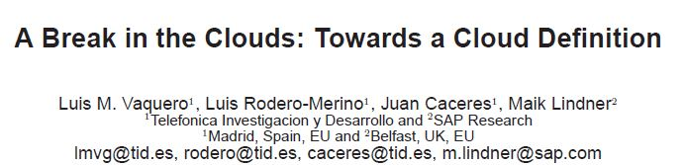
Defining the Cloud
Manish Potey

Slide 13
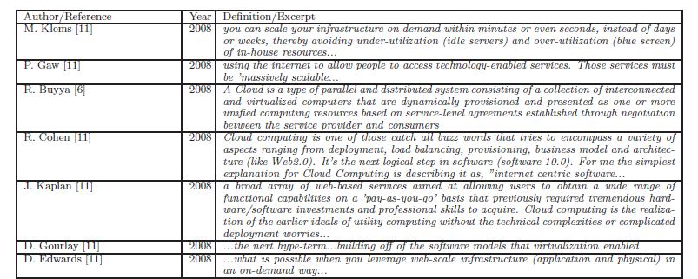
Defining the Cloud
Manish Potey

Slide 14
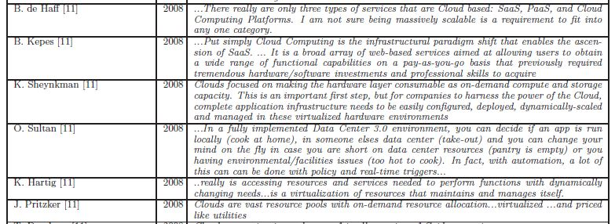
Defining the Cloud
Manish Potey

Slide 15
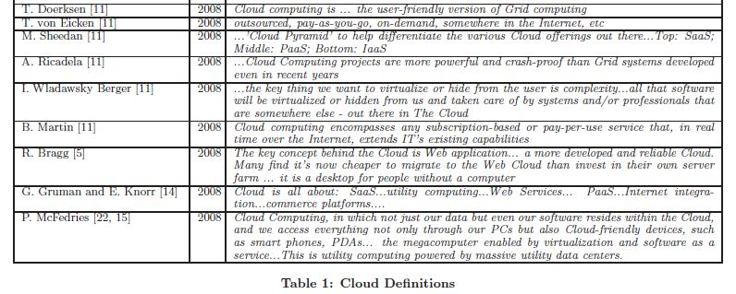
Defining the Cloud
Manish Potey

Slide 16
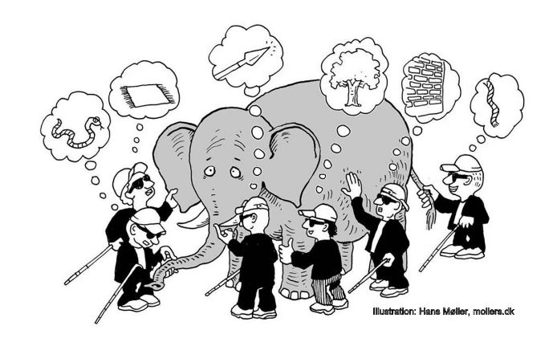
Defining the Cloud
Manish Potey

Slide 17
NIST Cloud Definition
Ubiquitous, convenient, on-demand network access to a shared pool of configurable computing resources (e.g., networks, servers, storage, applications, and services)
Essential characteristics (5)
  On-demand self-service , Broad network access, Resource pooling, Rapid elasticity, & Measured service
Three Service models (3)
  SaaS, PaaS, IaaS
Four Deployment models (4)
  Private, Public, Hybrid, Community
Manish Potey

Slide 18
NIST Cloud Definition
Cloud computing is a model for enabling ubiquitous, convenient, on-demand network access to a shared pool of configurable computing resources (e.g., networks, servers, storage, applications, and services) that can be rapidly provisioned and released with minimal management effort or service provider interaction
Manish Potey

Slide 19
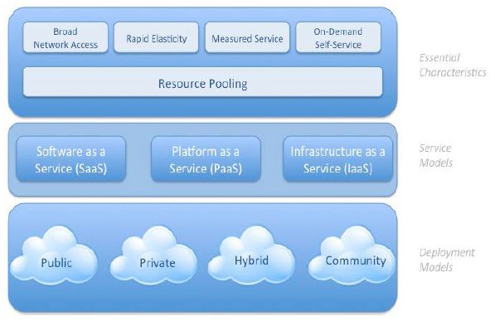
NIST Cloud Definition
NIST Cloud Definition – Pictorial representation
Manish Potey

Slide 20
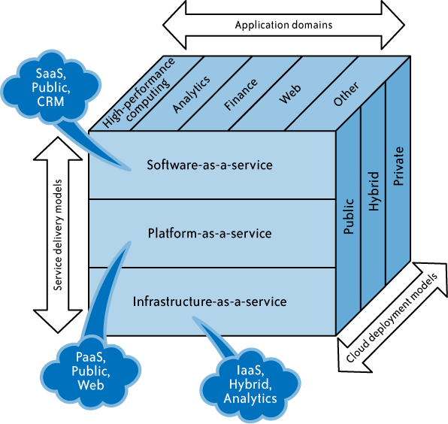
Cloud Computing : Definition
SPI service model
Manish Potey

Slide 21
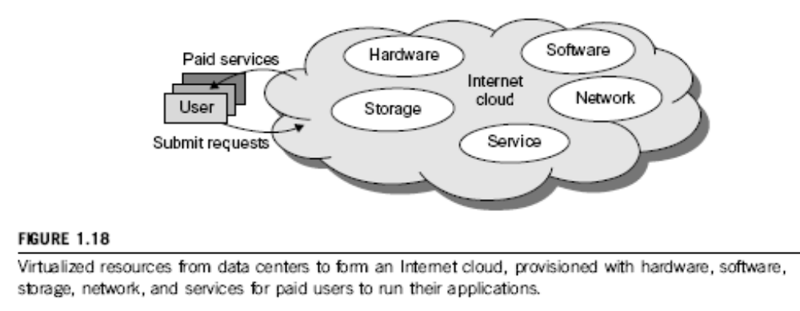
Cloud basics
Manish Potey

Slide 22
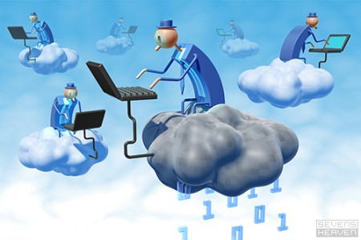
The Next Revolution in IT
Cloud Computing
Classical Computing
  Buy & Own
    Hardware, System Software, Applications often to meet peak needs.
  Install, Configure, Test, Verify, Evaluate
  Manage
  ..
  Finally, use it
  $$$$....$(High CapEx)
Cloud Computing
  Subscribe
  Use
  $ - pay for what you use, based on QoS
Every 18 months?
Manish Potey

Slide 23
Cloud Computing : Evolution
Cloud Computing is a nascent and rapidly evolving model
Cloud computing has its roots in large scale Distributed Computing
Technology
It is an extension of Grid, Distributed and Parallel Computing
Currently the organizations provide their Computing infrastructure
The emerging future, however, is one in which organizations will simply
plug in to the cloud (computing grid) for the computing resources they need.
As the Author Nicholas Carr puts it, “In the end the savings offered by
utilities become too compelling to resist, even for the largest enterprises.
The grid wins.”
Manish Potey

Slide 24
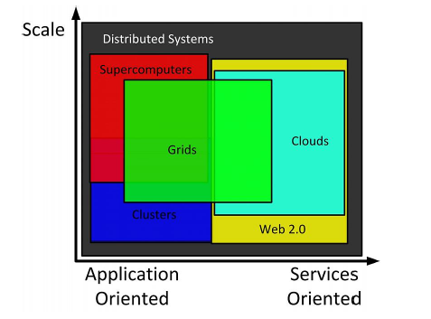
Comparison of Cloud and other domains
Manish Potey

Slide 25
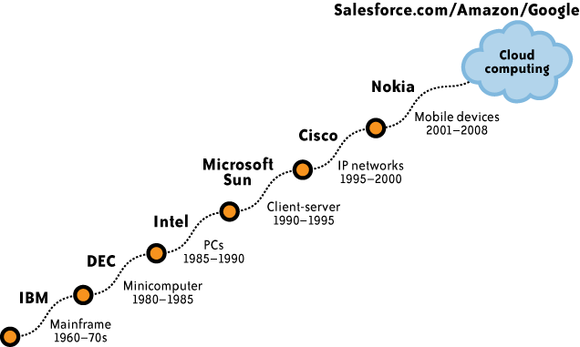
Cloud Computing : Evolution
Manish Potey

Slide 26
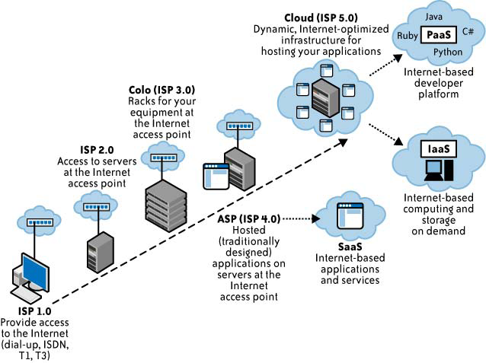
Cloud Computing : Evolution
Manish Potey

Slide 27
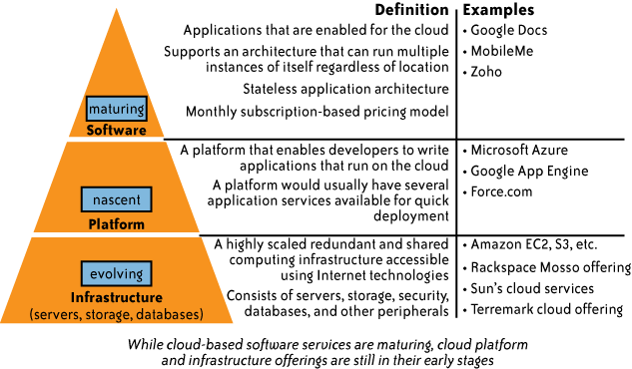
Cloud Computing
SPI service model
Manish Potey

Slide 28
Cloud Computing : Relevant Technologies
Cloud access devices
Browsers and thin clients
High-speed broadband access
Data centers and server farms
Storage devices
Virtualization technologies
APIs
Manish Potey

Slide 29
Cloud Computing : Key Drivers to its Adoption
Security
Privacy
Connectivity and Open Access
Reliability
Interoperability
Legal Issues
Open Standards
Compliance
Long-term Viability
Manish Potey

Slide 30
Cloud Computing Challenges:
Dealing with too many issues (Courtesy of R. Buyya)
Pricing
Scalability
Virtualization
Resource Metering
Reliability
QoS
Billing
Service Level
Agreements
Energy Efficiency
Provisioning
on Demand
Utility & Risk Management
Security
Legal &
Regulatory
Privacy
Software Eng. Complexity
Trust
Programming Env.
& Application Dev.
Manish Potey

Slide 31
Cloud Computing v/s Traditional dedicated IT Technologies
Traditional Software Applications V/s Cloud Computing SaaS Model
Traditional software applications involve a large Capital Expenditure (known as
CapEx)
In SaaS model, the customer rents it for use on pay-per-use model at an
operational expense, known as OpEx )
Traditional Software Development V/s Cloud Computing PaaS Model
In a platform-as-a-service (PaaS) model, the cloud service provider offers a
development environment to application developers on the cloud
Traditional Hosted Applications V/s Cloud Computing IaaS Model
The IaaS model is similar to utility computing, in which the idea is to offer
computing services in the same way as utilities. That is, the user pays for the amount of processing power, disk space, etc that you actually consume
Manish Potey

Slide 32
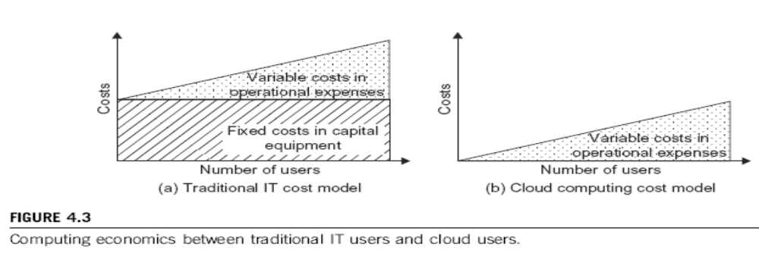
Cost-Effectiveness in Cloud Computing vs. Datacenter Utilization
(Courtesy of M. Ambrust, et al 2009)
Manish Potey

Slide 33
Historical Development
The idea of renting computing services by leveraging large distributed computing facilities has been around for long time. It dates back to the days of the mainframes in the early 1950s. From there on, technology has evolved and been refined.
This process has created a series of favorable conditions for the realization of cloud computing.
Figure 6 (Next slide) provides an overview of the evolution of the distributed computing technologies that have influenced cloud computing.
We briefly review five core technologies that played an important role in the realization of cloud computing.
These technologies are distributed systems, virtualization, Web 2.0, service orientation, and utility computing.
Manish Potey

Slide 34
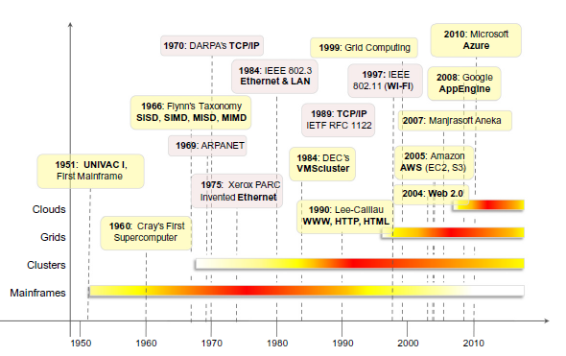
Historical Development
Fig. 6 - The evolutionofdistributedcomputingtechnologies,1950s2010s.
Manish Potey

Slide 35
Distributed Systems
Clouds are essentially large distributed computing facilities that make available their services to third parties on demand.
A distributed system is a collection of independent computers that appears to its users as a single coherent system
Distributed systems often exhibit other properties such as heterogeneity, openness, scalability, transparency, concurrency, continuous availability, and independent failures.
Three major milestones have led to cloud computing: mainframe computing, cluster computing, and grid computing
Manish Potey

Slide 36
(A) Mainframes
These were the first examples of large computational facilities leveraging multiple processing units. Mainframes were powerful, highly reliable computers specialized for large data movement and massive input/output (I/O) operations.
They were mostly used by large organizations for bulk data processing tasks such as online transactions, enterprise resource planning, and other operations involving the processing of significant amounts of data.
Even though mainframes cannot be considered distributed systems, they offered large computational power by using multiple processors, which were presented as a single entity to users.
One of the most attractive features of mainframes was the ability to be highly reliable computers that were “always on” and capable of tolerating failures transparently. No system shutdown was required to replace failed components, and the system could work without interruption. Batch processing was the main application of mainframes.
Now their popularity and deployments have reduced, but evolved versions of such systems are still in use for transaction processing (such as online banking, airline ticket booking, supermarket and telcos, and government services).
Manish Potey

Slide 37
(B) Clusters
Cluster computing started as a low-cost alternative to the use of mainframes and supercomputers.
The technology advancement that created faster and more powerful mainframes and supercomputers eventually generated an increased availability of cheap commodity machines as a side effect.
These machines could then be connected by a high-bandwidth network and controlled by specific software tools that manage them as a single system.
Starting in the 1980s, clusters become the standard technology for parallel and high-performance computing. Built by commodity machines, they were cheaper than mainframes and made high-performance computing available to a large number of groups, including universities and small research labs.
Cluster technology contributed considerably to the evolution of tools and frameworks for distributed computing, including Condor , Parallel Virtual Machine (PVM) , and Message Passing Interface (MPI)
One of the attractive features of clusters was that the computational power of commodity machines could be leveraged to solve problems that were previously manageable only on expensive supercomputers.
Manish Potey

Slide 38
(C) Grids
Grid computing appeared in the early 1990s as an evolution of cluster computing
A computing grid was a dynamic aggregation of heterogeneous computing nodes, and its scale was nationwide or even worldwide.
Several developments made possible the diffusion of computing grids:
  clusters became quite common resources
  they were often underutilized;
  new problems were requiring computational power that went beyond the capability of single clusters; and
  the improvements in networking and the diffusion of the Internet made possible long-distance, high-bandwidth connectivity.
All these elements led to the development of grids, which now serve a multitude of users across the world.
Manish Potey

Slide 39
Virtualization
. Virtualization confers that degree of customization and control that makes cloud computing appealing for users and, at the same time, sustainable for cloud services providers
Virtualization is essentially a technology that allows creation of different computing environments
Virtualization technologies are also used to replicate runtime environments for programs
Applications in the case of process virtual machines (which include the foundation of technologies such as Java or .NET), instead of being executed by the operating system, are run by a specific program called a virtual machine
Having isolated and customizable environments with minor impact on performance is what makes virtualization a attractive technology
Manish Potey

Slide 40
Web 2.0
The Web is the primary interface through which cloud computing delivers its services.
Web 2.0 brings interactivity and flexibility into Web pages, providing enhanced user experience by gaining Web-based access to all the functions that are normally found in desktop applications –XML, AJAX, Web Services
Examples of Web 2.0 applications are Google Documents, Google Maps, Flickr, Facebook, Twitter, YouTube, de.li.cious, Blogger, and Wikipedia
social networking Websites take the biggest advantage of Web 2.0. The level of interaction in Websites such as Facebook or Flickr would not have been possible without the support of AJAX
Manish Potey

Slide 41
Service Oriented Computing
Service orientation is the core reference model for cloud computing systems.
This approach adopts the concept of services as the main building blocks of application and system development
A service is an abstraction representing a self-describing and platform-agnostic component that can perform any function—anything from a simple function to a complex business process.
A service is supposed to be loosely coupled, reusable, programming language independent, and location transparent.
Service-oriented computing introduces and diffuses two important concepts, which are also fundamental to cloud computing: quality of service (QoS) and Software-as-a-Service (SaaS)
One of the most popular expressions of service orientation is represented by Web Services
Manish Potey

Slide 42
Utility Oriented Computing
Utility computing is a vision of computing that defines a service-provisioning model for compute services in which resources such as storage, compute power, applications, and infrastructure are packaged and offered on a pay-per-use basis
The first traces of this service-provisioning model can be found in the mainframe era. IBM and other mainframe providers offered mainframe power to organizations such as banks and government agencies throughout their datacenters
From an application and system development perspective, service-oriented computing and service-oriented architectures (SOAs) introduced the idea of leveraging external services for performing a specific task within a software system
Manish Potey

Slide 43
Building Cloud Computing Environment
Application Development
Infrastructure and System Development
Manish Potey

Slide 44
Cloud Computing Platforms & Technologies
AWS
GAE
Microsoft Azure
Hadoop
Force.com
Manjarasoft Aneka
Manish Potey

Slide 45
Various Cloud Computing Standard bodies / Forums
Cloud Security Alliance https://cloudsecurityalliance.org/
Cloud Standards Customer Council http://www.cloud-council.org/
Distributed Management Task Force (DMTF) http://www.dmtf.org/
The European Telecommunications Standards Institute (ETSI) http://www.etsi.org/
National Institute of Standards and Technology (NIST) http://www.nist.gov/itl/cloud/
Open Grid Forum (OGF) - http://www.ogf.org/
Object Management Group (OMG) - http://www.omg.org/
Open Cloud Consortium (OCC) - http://www.opencloudconsortium.org/
Organization for the Advancement of Structured Information Standards (OASIS) - http://www.oasis-open.org/
Storage Networking Industry Association (SNIA) - http://www.snia.org/
The Open Group - http://www.opengroup.org/
Association for Retail Technology Standards (ARTS) - http://www.nrf-arts.org/
TM Forum - http://www.tmforum.org/
Manish Potey

Slide 46
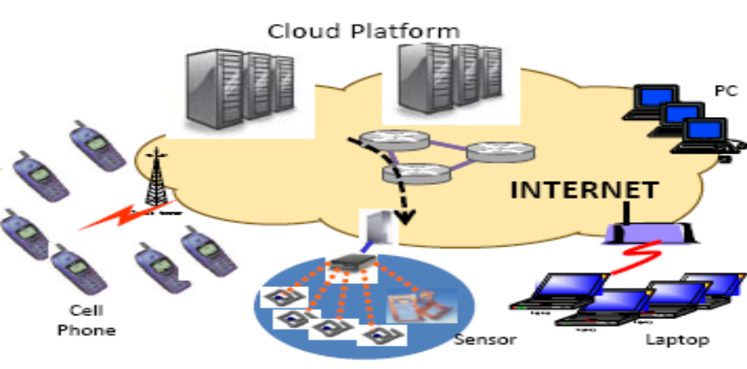
Cloud Roles in The Future Internet
(Courtesy of G. Xie and Z. Li 2012)
March 5, 2012
Manish Potey
Prof. Kai Hwang, USC

Slide 47













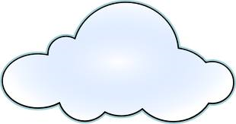



Subscription-Oriented Cloud Services
X (compute, apps, data, ..) as a Service (.. aaS)
Public Cloud
Cloud
Manager
Private
Cloud
Clients
(Courtesy of Raj Buyya, 2012)
Other
Cloud Services
Govt.
Cloud Services
Manish Potey

Slide 48
Three Aspects in Hardware that can
benefit from Cloud Computing
The illusion of infinite computing resources available on demand, thereby eliminating the need for cloud users to plan far ahead for resource provisioning.
The elimination of an up-front commitment by cloud users, thereby allowing companies to start small and increase the hardware resources when needed in the future.
The ability to pay the costs of computing resources on a short-term basis as needed (e.g., processors by the hour and storage by the day) and release them after done and thereby rewarding resource conservation.
(Courtesy of M. Ambrust, et al 2009)
Manish Potey

Slide 49
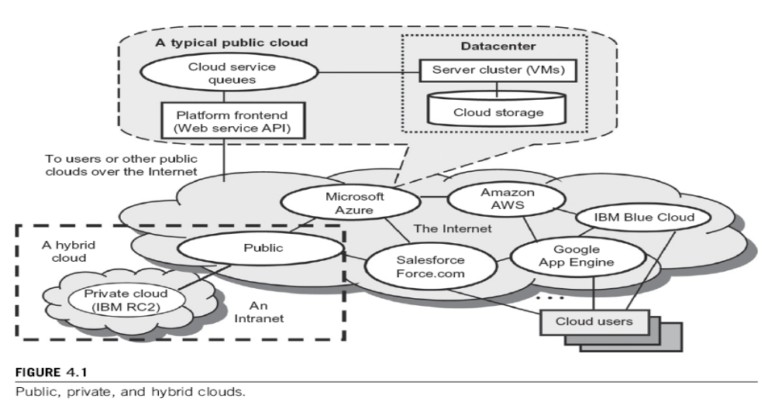
Manish Potey

Slide 50
Public Clouds vs. Private Clouds :
Characteristics | Public clouds | Private clouds
Technology leverage and ownership | Owned by service providers | Leverage existing IT infrastructure and personnel; owned by individual organization
Management of provisioned resources | Creating and managing VM instances within proprietary infrastructure; promote standardization, preserves capital investment, application flexibility | Client managed; achieve customization and offer higher efficiency
Workload distribution methods and loading policies | Handle workload without communication dependency; distribute data and VM resources; surge workload is off-loaded | Handle workload dynamically, but can better balance workloads; distribute data and VM resources
Security and data privacy enforcement | Publicly accessible through remote interface | Access is limited; provide pre-production testing and enforce data privacy and security policies
Example platforms | Google App Engine, Amazon AWS, Microsoft Azure | IBM RC2
Manish Potey

Slide 51
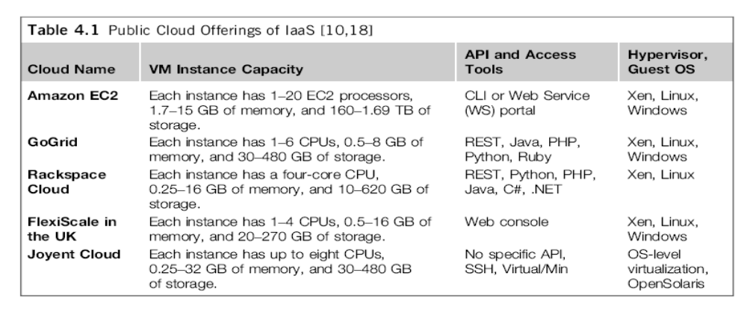
Some IaaS Offerings from Public Clouds :
Manish Potey

Slide 52
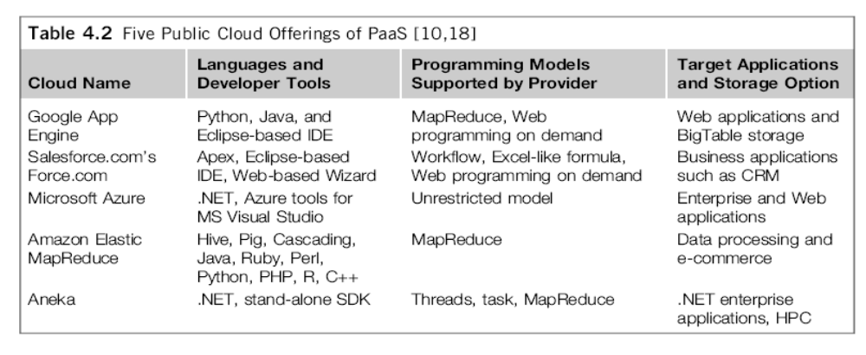
PaaS Offerings from Public Clouds
Deepak H. Sharma

Slide 53
Cloud Computing : Security Issues
Infrastructure Security : Security capabilities at
  At the Network level
  At the Host level
  At the Application level
Data Security and Storage : Including aspects of
  Confidentiality, integrity and availability
Identity and Access Management : Capabilities of
  Authentication, Authorization and Auditing of users
Manish Potey

Slide 54
Challenges in Cloud Computing (1)
Concerns from The Industry (Providers)
  Replacement Cost
    Exponential increase in cost to maintain the infrastructure
  Vendor Lock-in
    No standard API or protocol can be very serious
  Standardization
    No standard metric for QoS is limiting the popularity
  Security and Confidentiality
    Trust model for cloud computing
  Control Mechanism
    Users do not have any control over infrastructures
Manish Potey

Slide 55
Challenges in Cloud Computing (2)
Concerns from Research Community :
  Conflict to legacy programs
    With difficulty in developing a new application due to lack of control
  Provenance
    How to reproduce results in different infrastructures
  Reduction in Latency
    No specially designed interconnect used
    Very low controllability in layout of interconnect due to abstraction
  Programming Model
    Hard to debug where programming naturally error-prone
    Details about infrastructure are hidden
  QoS Measurement
    Especially for ubiquitous computing where context changes
Manish Potey

Slide 56
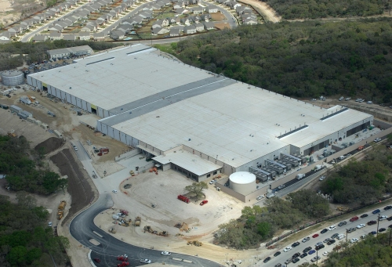

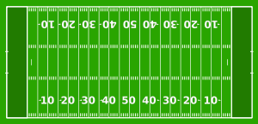

Cloud is built on Massive Datacenters
Range in size from “edge” facilities to megascale (100K to 1M servers)
Economies of scale
  Approximate costs for a small size center (1K servers) and a larger, 400K server center.
Technology | Cost in small-sized Data Center | Cost in Large Data Center | Ratio
Network | $95 per Mbps/ Month | $13 per Mbps/ month | 7.1
Storage | $2.20 per GB/ Month | $0.40 per GB/ month | 5.7
Administra-tion | ~140 servers/ Administrator | >1000 Servers/ Administrator | 7.1
This data center is
11.5 times
the size of a football field
Manish Potey

Slide 57
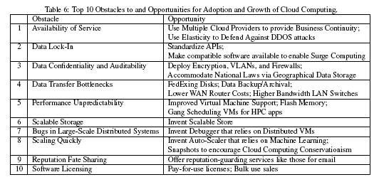
Top 10 Obstacles and Opportunities
for Cloud Computing
(Courtesy of M. Ambrust, et al 2009)
Manish Potey

Slide 58
Virtualization Basics
Manish Potey

Slide 59
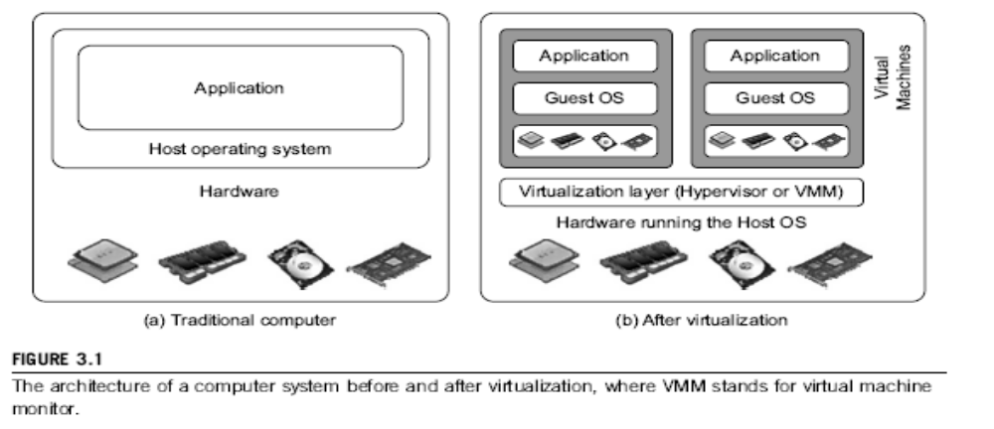
Difference between Traditional Computer and Virtual machines
Manish Potey

Slide 60
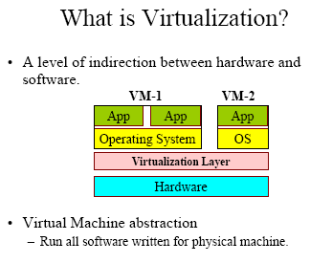
What is Virtualization ?
Manish Potey

Slide 61
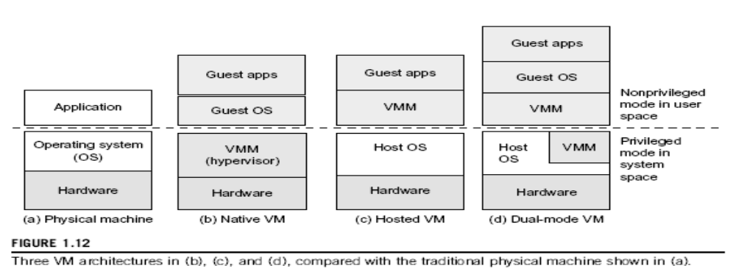
Manish Potey

Slide 62
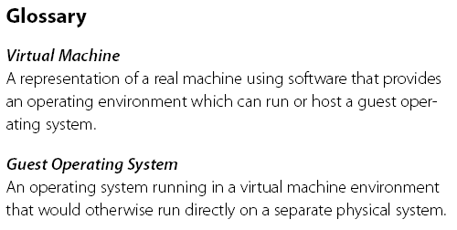
Virtual Machine, Guest Operating System, and VMM (Virtual Machine Monitor) :
The Virtualization layer is the middleware between the underlying hardware and virtual machines represented in the system, also known as virtual machine monitor (VMM).
Manish Potey

Slide 63
Hypervisor
A hypervisor is a hardware virtualization technique allowing multiple operating systems, called guests to run on a host machine. This is also called the Virtual Machine Monitor (VMM).
Type 1 hypervisor or the bare metal hypervisor sits on the bare metal computer hardware like the CPU, memory, etc. All the guest operating systems are a layer above the hypervisor. So the hypervisor is the first layer over the hardware. The original CP/CMS hypervisor developed by IBM was of this kind. Examples are Microsoft Hyper-V.
Type 2 or the hosted hypervisor do not run over the bare metal hardware but they run over a host operating system. The hypervisor is the second layer over the hardware. The guest operating systems run a layer over the hypervisor and so they form the third layer. Examples are FreeBSD. The operating system is usually unaware of the virtualization
Manish Potey

Slide 64
Full Virtualization vs. Para-Virtualization
Full virtualization does not need to modify guest OS, and critical instructions are emulated by software through the use of binary translation. On the other hand, para virtualization needs to modify guest OS, and non-virtualizable instructions are replaced by hypercalls that communicate directly with the hypervisor or VMM. As of full virtualization, the advantage is no need to modify OS. However, this approach of binary translation slows down the performance a lot.
Para virtualization reduces the overhead, but the cost of maintaining paravirtualized OS is high. The improvement depends on the workload. VMware Workstation applies full virtualization, which uses binary translation to automatically modify x86 software on-the-fly to replace critical instructions. The para virtualization is supported by Xen, Denali and VMware ESX.
Manish Potey

Slide 65
Para-Virtualization
In para-virtualization, the guest operating system has to be modified. Para-virtualization provides specially defined ‘hooks’ to do some tasks in the host and guest operating systems, which would otherwise have been done in a virtual environment, which is slower.
The VMM in a para-virtualized platform is simpler because the critical tasks are now performed in the operating system rater than by the VMM. Since the virtualization overhead decreases the performance increases.
Some of the disadvantages are the compatibility and the portability is reduces because of the modified operating system. Also the cost of maintenance is high because of the deep OS modifications.
Some examples of Para-virtualization are KVM and the XenWindowsGplPv project.
Manish Potey

Slide 66
References
K. Hwang, G. Fox, and J. Dongarra, Distributed and Cloud Computing: from Parallel Processing to the Internet of Things Morgan Kauffmann Publishers, 2011
R. Buyya, J. Broberg, and A. Goscinski (eds), Cloud Computing: Principles and Paradigms, ISBN-13: 978-0470887998, Wiley Press, USA, February 2011.
T. Chou, Introduction to Cloud Computing: Business and Technology, Lecture Notes at Stanford University and at Tsinghua University, Active Book Press, 2010.
Vaquero, Luis M., et al. "A break in the clouds: towards a cloud definition." ACM SIGCOMM Computer Communication Review 39.1 (2008): 50-55.
Manish Potey

Slide 67
References
Mell, Peter, and Tim Grance. "The NIST definition of cloud computing." (2011).
Mather, Tim, Subra Kumaraswamy, and Shahed Latif. Cloud security and privacy: an enterprise perspective on risks and compliance. " O'Reilly Media, Inc.", 2009.
Foster, Ian, et al. "Cloud computing and grid computing 360-degree compared." 2008 Grid Computing Environments Workshop. IEEE, 2008.
Armbrust, Michael, et al. "Above the clouds: A berkeley view of cloud computing." (2009).
Xie, G., et al. "A survey on future Internet architecture." Chinese Journal of Computers 35.6 (2012): 1109-1119.
Manish Potey

Slide 68
C – Cloud Computing (Overview)
Summary
1 Cloud Computing overview
2 Cloud Deployment models
3 Cloud Service models
4 Virtualization Basics
5 IaaS, PaaS, SaaS
6 Benefits of cloud
7 Impact of cloud computing in business
8 Trends in Cloud computing, challenges
9 Case study (next session)
Manish Potey

Slide 69

THANK YOU !
Manish Potey

